Slide 1











Adverbs
Adverbs

Slide 2

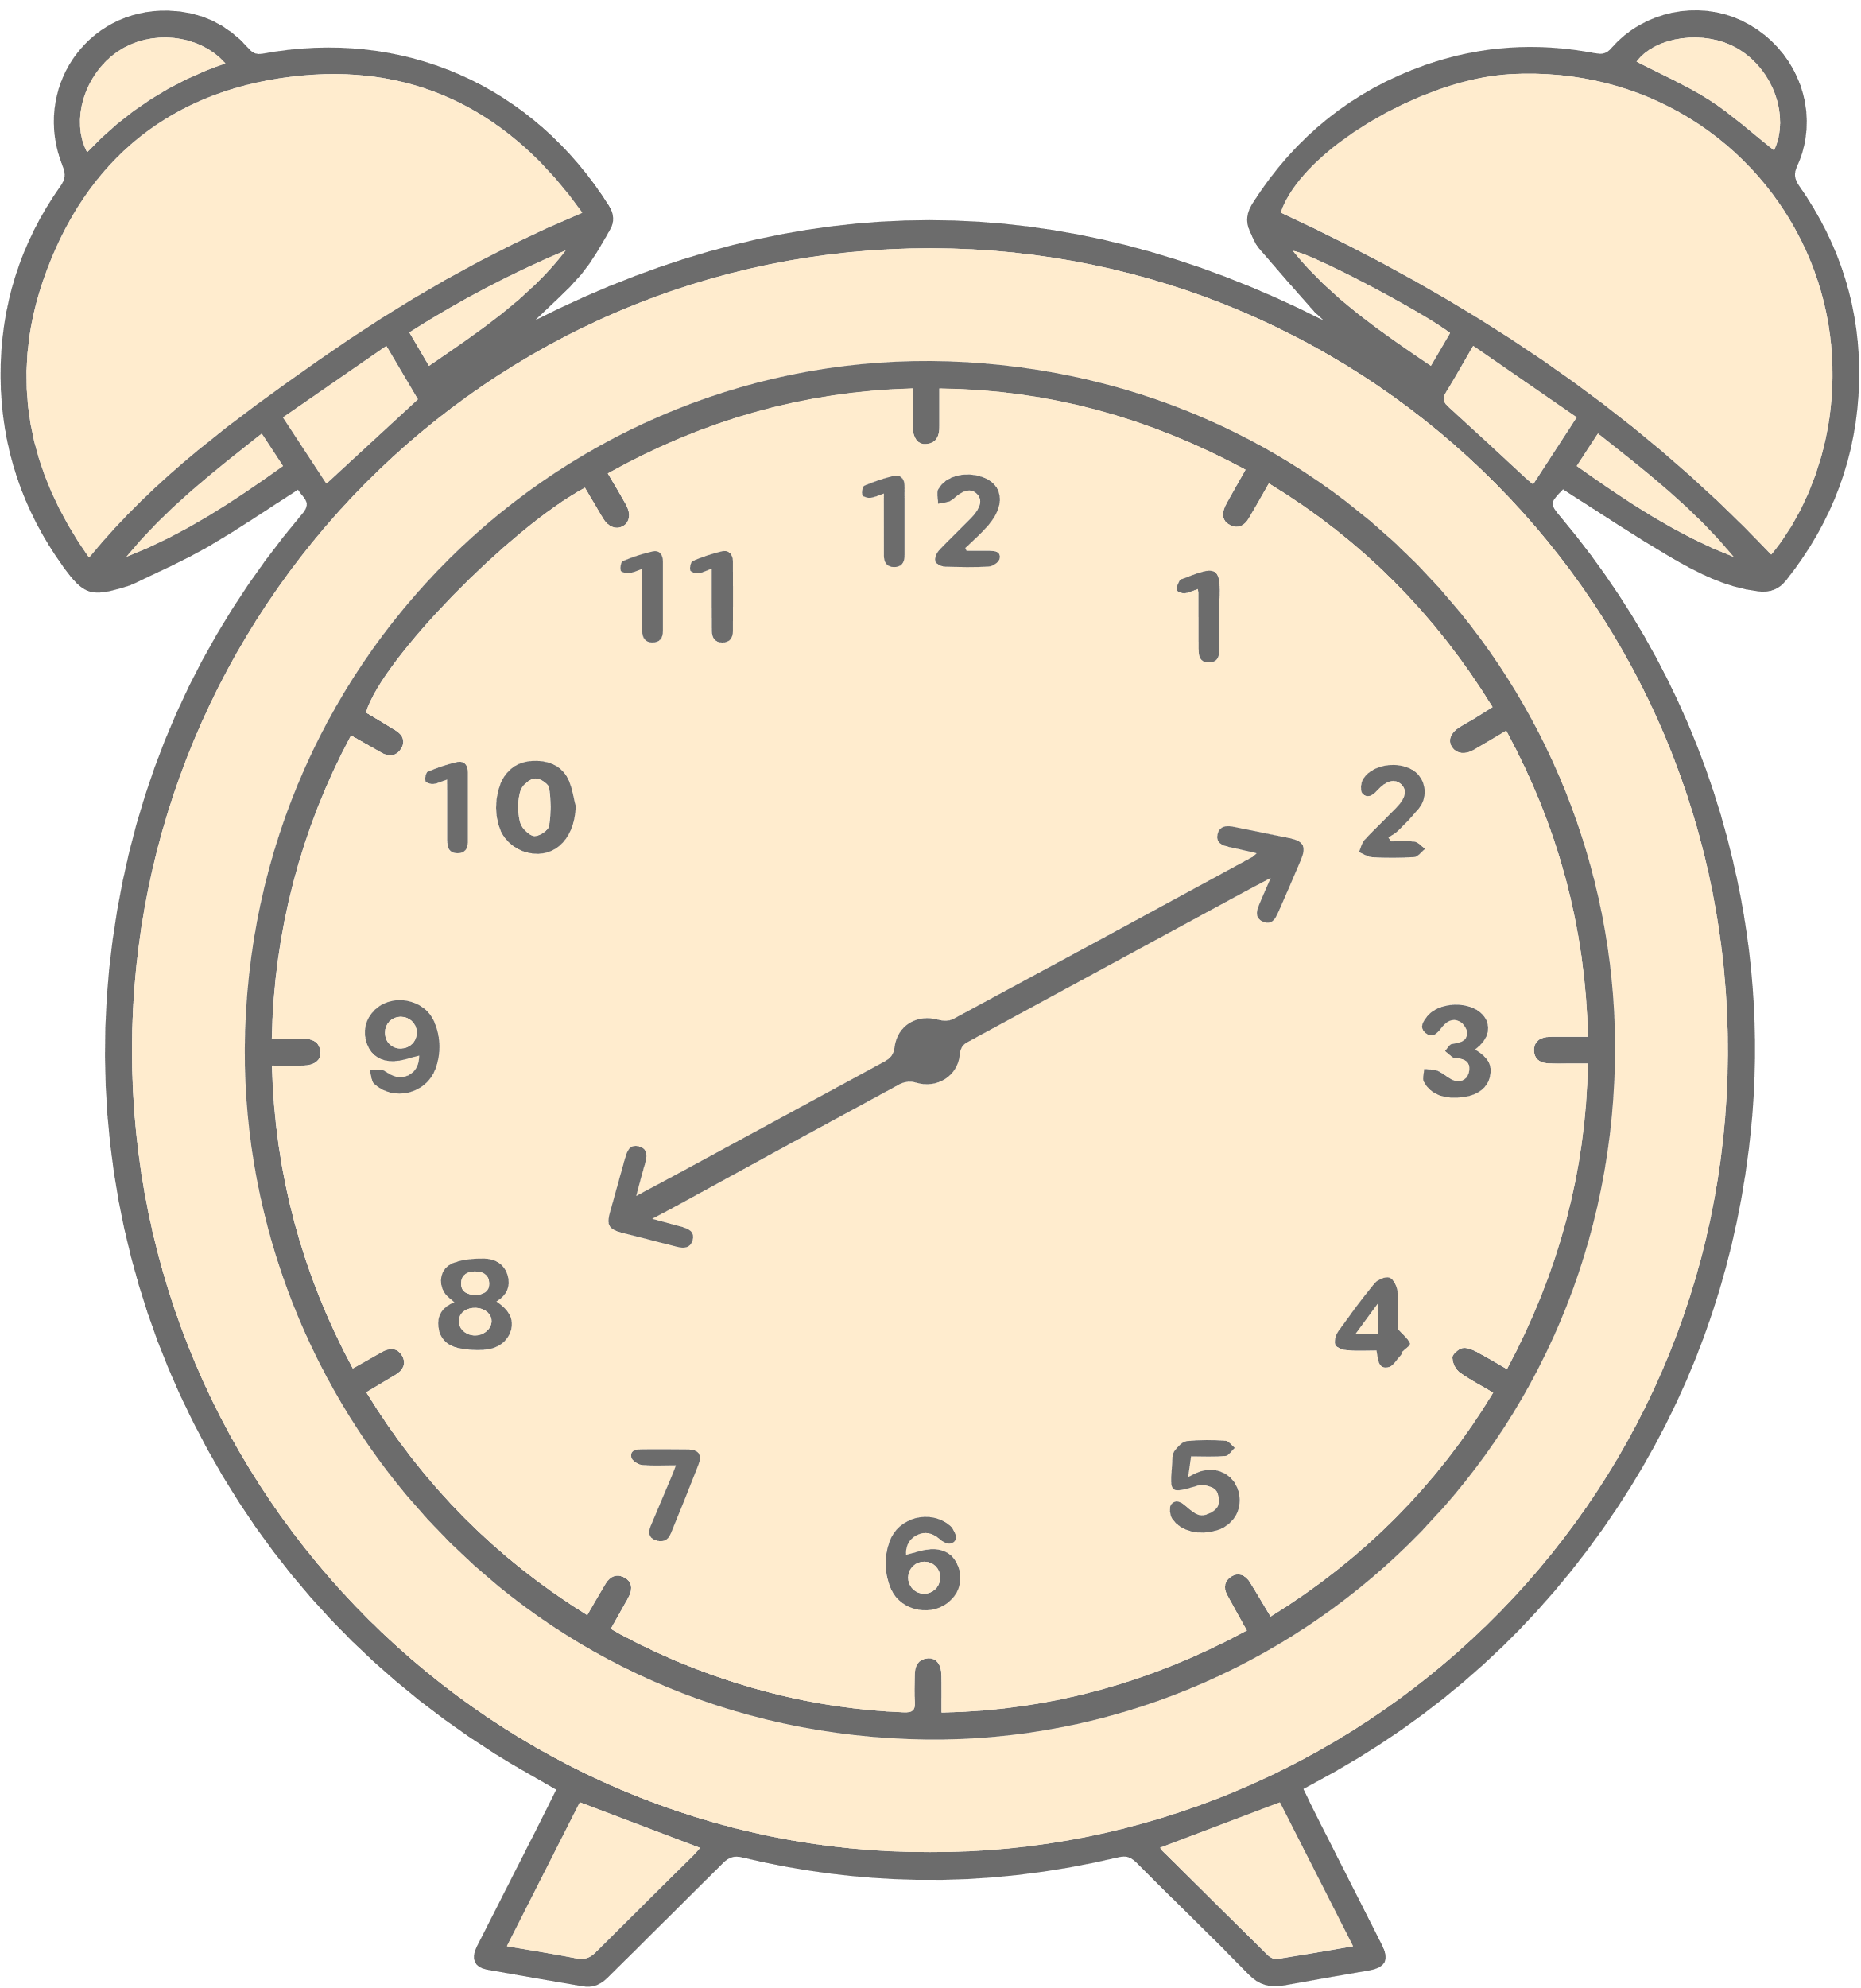








What are adverbs?
What are adverbs?
An adverb is a word that modifies (describes) a verb (“he sings loudly”), an adjective (“very tall”), another adverb (“ended too quickly”), or even a whole sentence (“Fortunately, I had brought an umbrella.”).

Slide 3




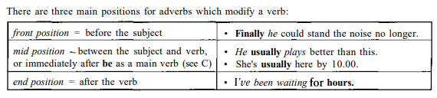
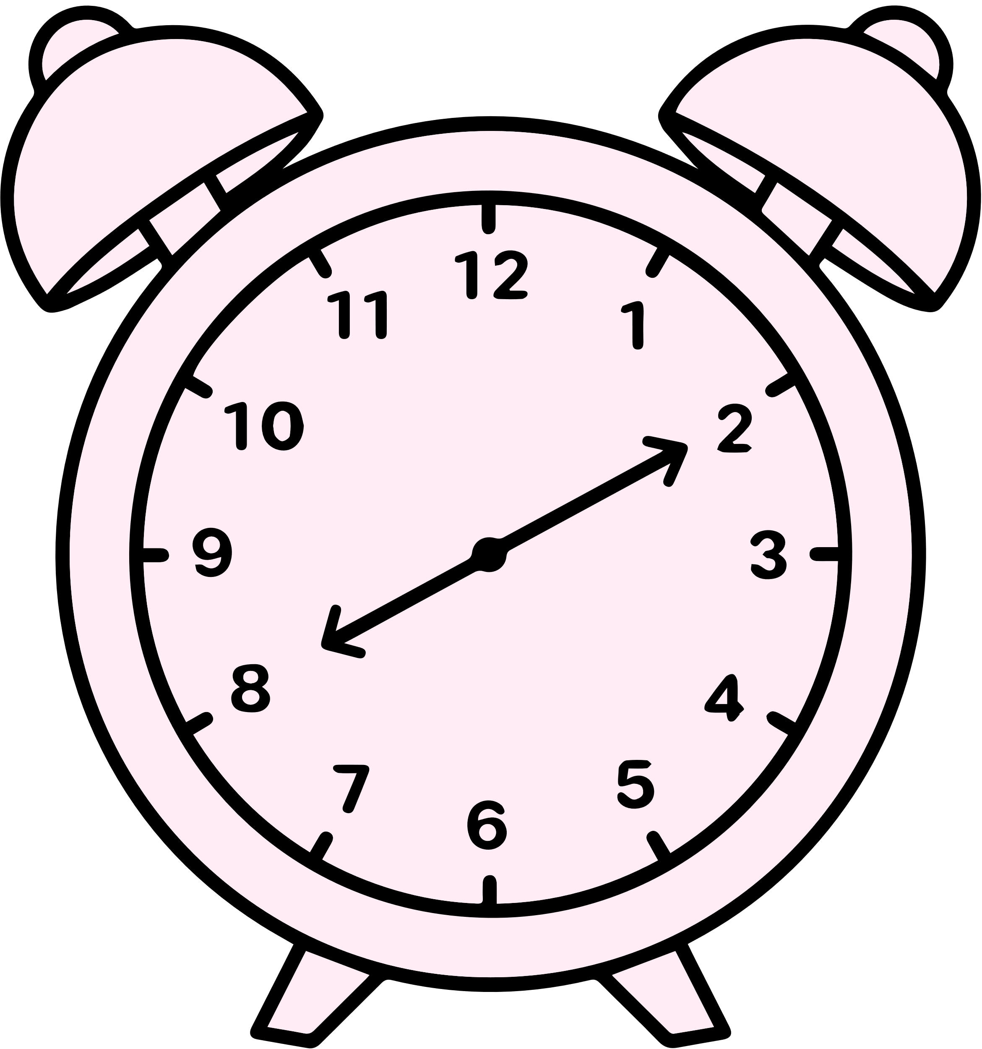

Position of Adverbs

Slide 4





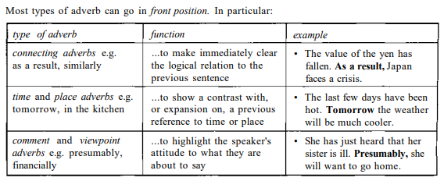
Front Position

Slide 5

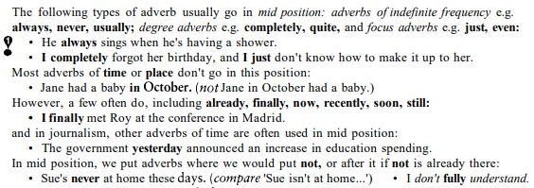
Mid Position

Slide 6
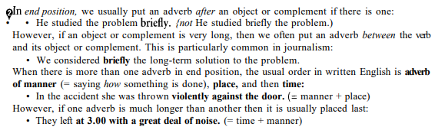
End Position

Slide 7
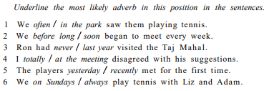


Activity
Underline the most likely adverb in this position in the sentences.

Slide 8



Adverbs of Place
Adverbs of place usually go in end position but we can also put them in front position, to show a contrast or expansion.

Slide 9
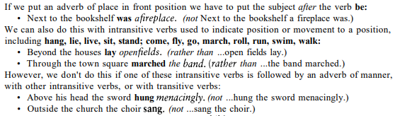
Adverbs of Place

Slide 10
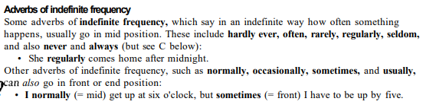
Adverbs of Indefinite Frequency

Slide 11




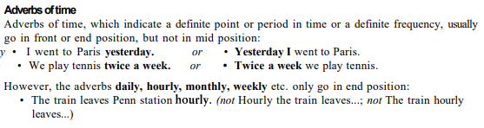


Abverbs of Time

Slide 12


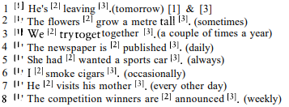

Activity
EX:

Slide 13







What are Prepositions?
Preposition, a word that indicates the relationship of a noun, pronoun, or noun phrase (a group of words that function collectively as a noun) to another word or phrase in a sentence.
Ex: The ball is rolling into the box.

Slide 14


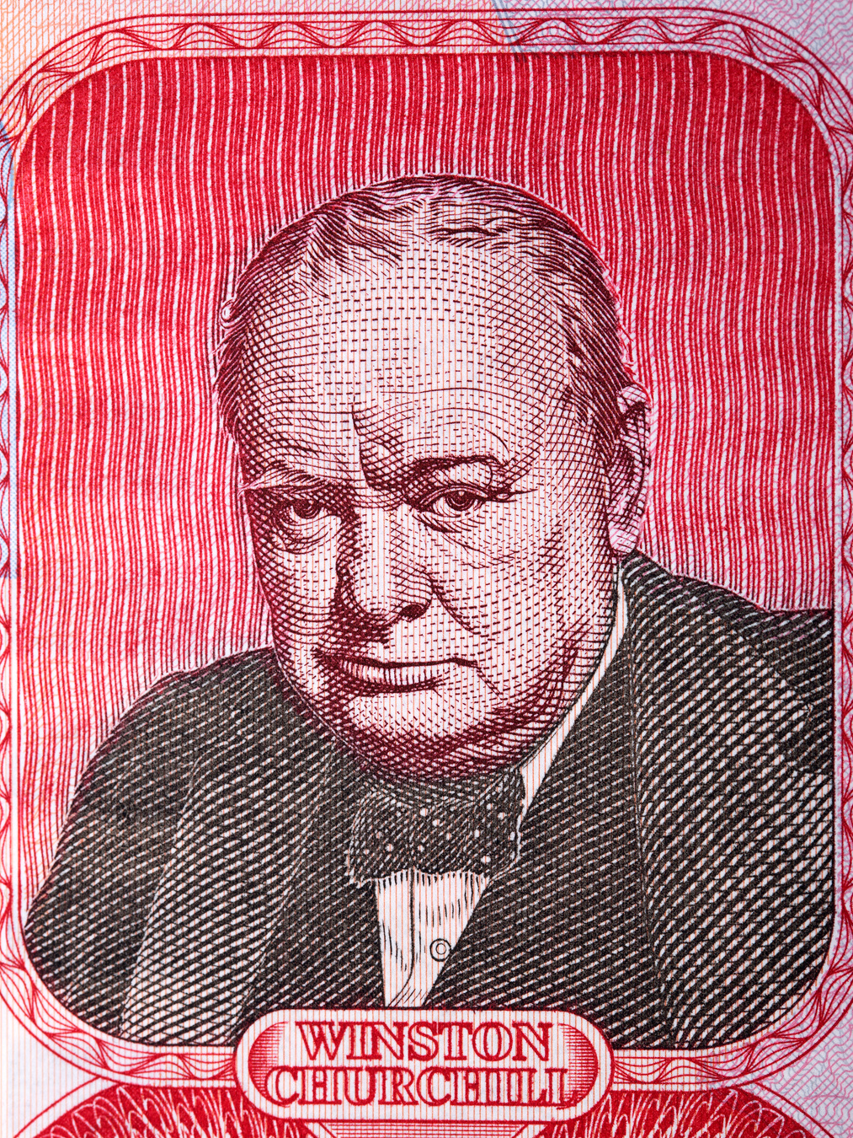
Prepositions after verbs
learn about/of &c know about/of : We use either about or of with learn and know when we talk about something that happens to somebody or something, or about a particular event.
Ex: I have just learnt about/of the death of Dr Brown.
What little is known about/of the plans suggests they will be unpopular.
know &c know about/of: We use know + noun when we talk about personal experience of people and things.
Ex: My uncle knew Churchill, and
The whole country knew about/of Churchill's love of cigars

Slide 15



ask about &c enquire about: We use ask about or enquire (or inquire) about when we talk about getting information about something or someone. Ex: He got angry when they started to ask about / enquire about his private life.
ask after &c enquire after: We use ask after or enquire (or inquire) after to ask for information about a person (but not a thing), particularly concerning their health. Ex: I'm phoning to ask (or enquire) after/about Mrs. Brown. She's in Ward 4.
ask for: You use ask for (not 'enquire for') to ask someone to give you something or do something. Ex: He finished the drink quickly and asked for another.

Slide 16
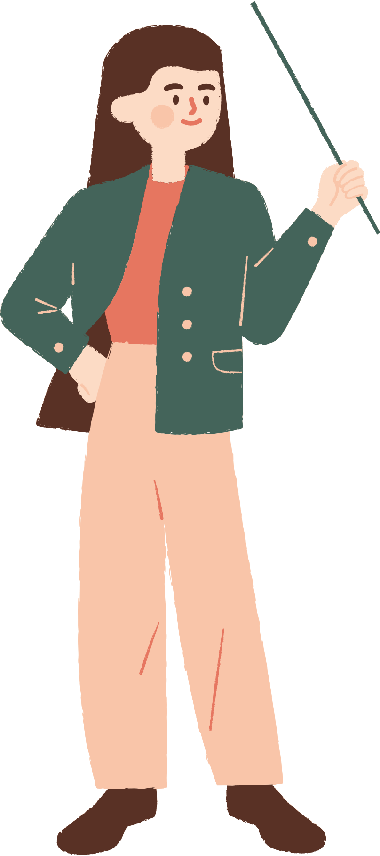

enquire into: When we enquire into some organisation, event or person we try to find out facts in order to investigate them.
Ex: The body has been set up to enquire into near-accidents reported by airline pilot
think of/about : Think of is preferred when you talk about something that suddenly enters your mind (it occurs to you) and think about when you talk about something that you consider over a longer period:
Ex: He suddenly thought of Hilary. Perhaps she would help
Your job is to think about safety and nothing else.

Slide 17
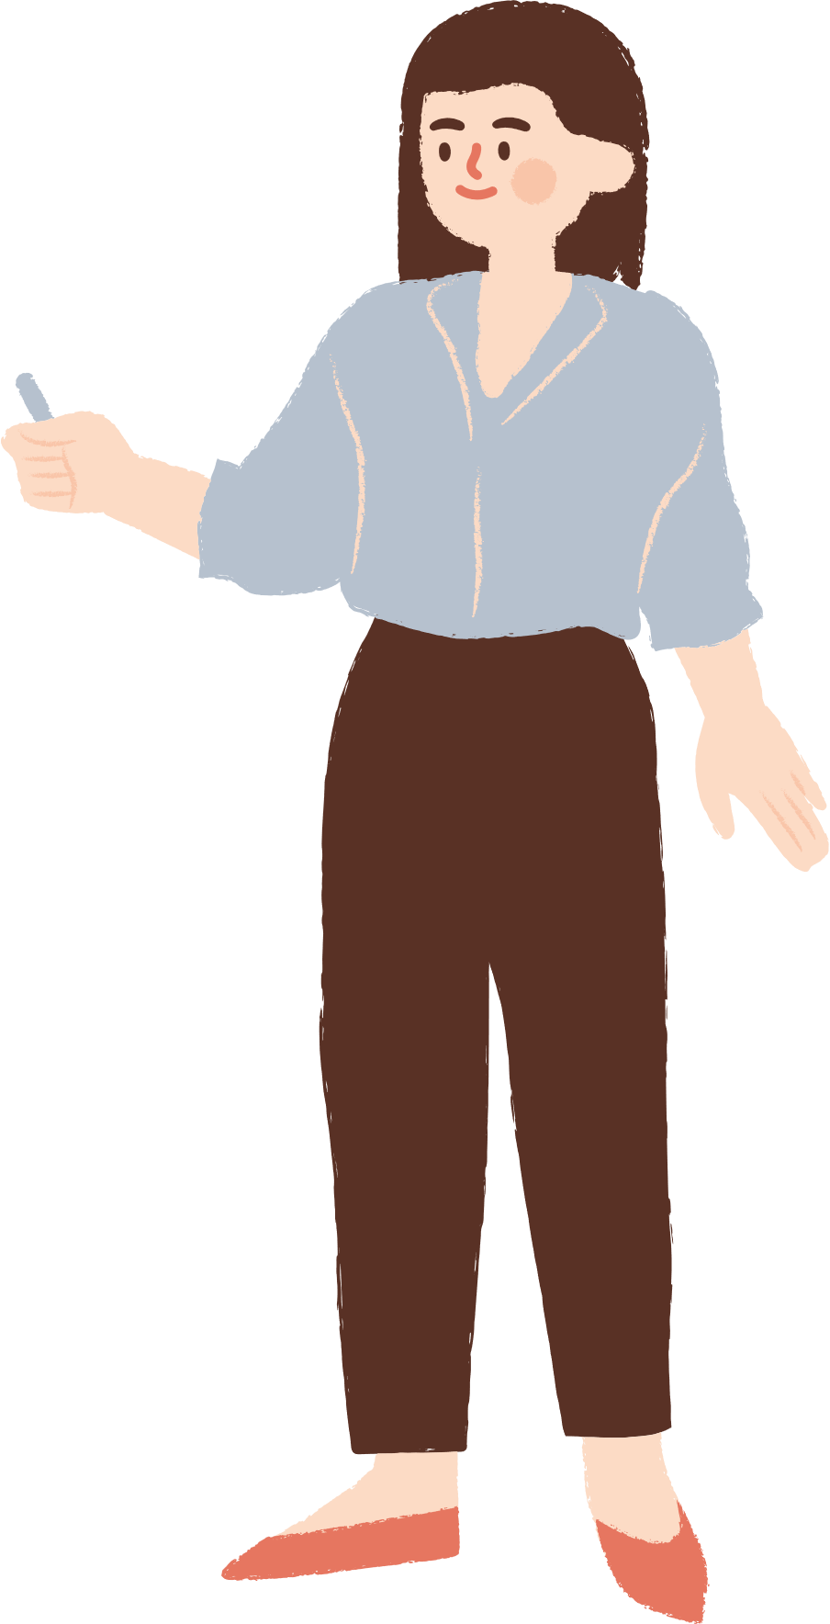

hear about/of : We can use either hear about or hear of when we talk about gaining information about someone or something:
Ex: I heard about/of this restaurant through Pam.
hear from We use hear from when we talk about receiving some communication - e.g. a phone call or letter - from somebody:
Ex: I heard from Pauline recently. She told me she's moving back to Greece

Slide 18


laugh about/at We can say we laugh at an amusing person, thing or situation, or something we don't take seriously, when the amusing thing, etc., is present.
Ex: We spent a happy couple of hours laughing at photos from the party.
We use laugh about when we are remembering the amusing person, thing or situation at a later date:
Ex: The program was so funny! We laugh about it every time we think of it.

Slide 19
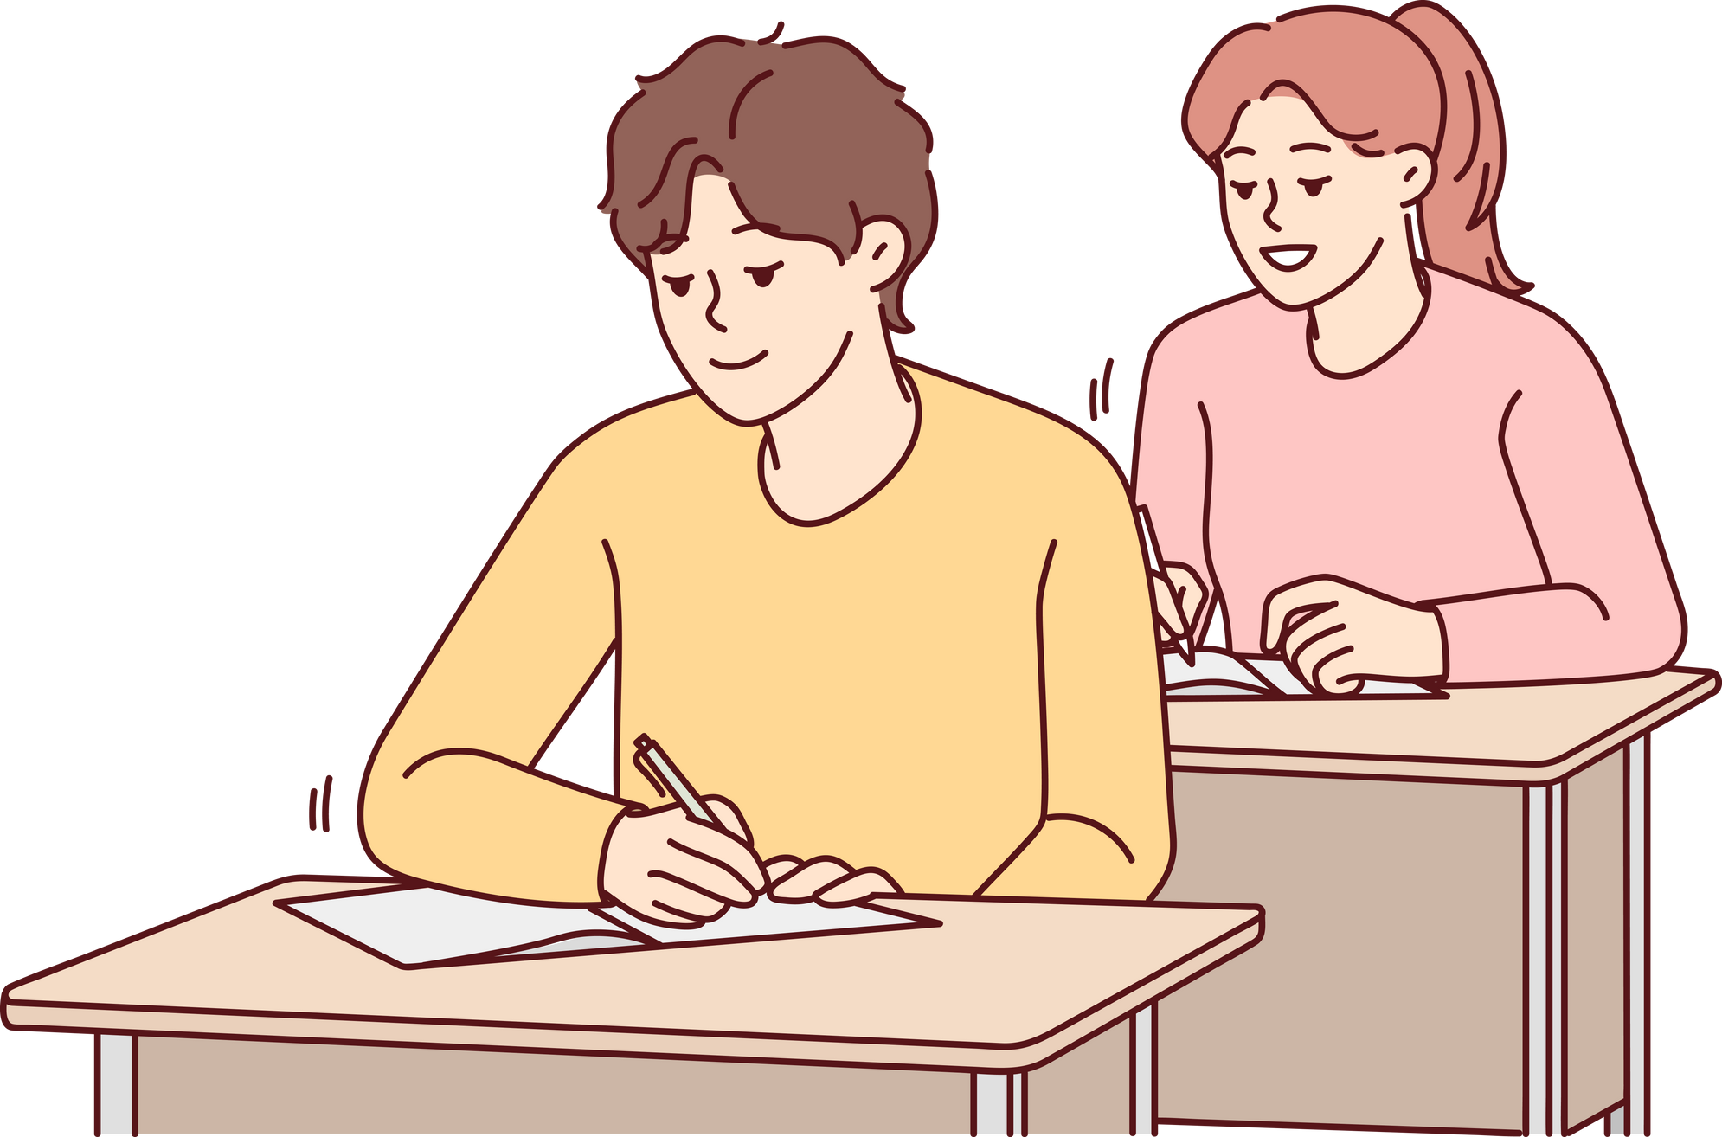
agree on: We use agree on to say that two or more people decide something
Ex: We agreed on a time and place to meet.
agree about: We use agree about to say that people have the same opinion on a particular subject.
Ex: Something that everyone can agree about is that we all want to be happy.

Slide 20


agree with: We use agree with to say that two people have the same opinion; to say that you approve of a particular idea or action; or to say that two things match.
Ex: I agree with letting children choose the clothes they want to wear
agree to: We use agree to to say that someone allows something to happen, or to say that someone is prepared to do something
Ex: Once the government agreed to the scheme it went ahead without delay.

Slide 21


care about/for: We use either care about or care for to talk about feeling affection for someone
Ex: If you really cared about/for me, you wouldn't spend so much time away from home.
shout/point/throw at/to: You shout at someone because you are angry with them
Ex: Don't shout at me, I'm doing my best!
You shout to someone who is a long way from you so that they can hear
Ex: The taxi driver shouted to someone across the street. 'Is the station near here?'

Slide 22

We use point something at when we aim a knife, camera, finger, etc. in a particular direction:
Ex: She pointed the knife at me and started to laugh.
When you point at or point to something, you show where something is by holding out your finger (we can also use point towards)
Ex: The food's over there,' said Toni, pointing at/to/towards the corner of the room.

Slide 23
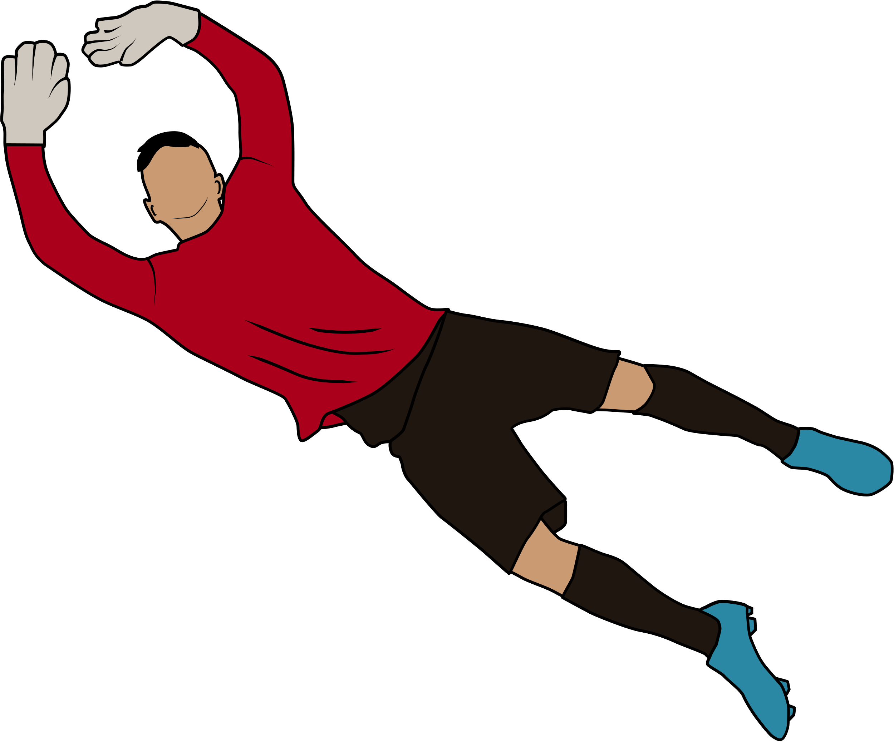
We throw something to someone for them to catch it.
Ex: Fletcher picked up the ball and threw it back to the goalkeeper.
We throw something at something or someone to try to hit them:
Ex: A monkey was sitting in the tree, throwing nuts at anyone who walked past

Slide 24

wonder about: If we wonder about doing something, we think about doing it in the future, or say that we want to know about something or someone:
Ex: I've been wondering about visiting Lynn.
wonder at If we wonder at something, we say that we are surprised at it or impressed by it.
Ex: The children had their faces pressed to the glass of the cage, wondering at the tigers they could see only inches away on the other side.

Slide 25














Thank You
Thank You

